Slide 1
Electron
Lecturer: Ngo Huy Bien
Software Engineering Department
Faculty of Information Technology
VNUHCM - University of Science
Ho Chi Minh City, Vietnam
nhbien@fit.hcmus.edu.vn

Slide 2

Objectives

Slide 3

Contents

Slide 4

References

Slide 5
What is Electron?
https://www.electronjs.org/docs/latest/
Electron is a framework for building desktop applications using JavaScript, HTML, and CSS.
By embedding Chromium and Node.js into its binary, Electron allows you to maintain one JavaScript codebase and create cross-platform apps that work on Windows, macOS, and Linux — no native development experience required.

Slide 6
Why Use Electron?
https://www.electronjs.org/docs/latest/why-electron
Enterprise-grade
Electron is reliable, secure, stable, and mature. It is the premier choice for companies building their flagship product. We have a list of some of those companies on our homepage, but just among chat apps, Slack, Discord, and Skype are built with Electron. Among AI applications, both OpenAI’s ChatGPT and Anthropic’s Claude use Electron. Visual Studio Code, Loom, Canva, Notion, Docker, and countless other leading developers of software bet on Electron.

Slide 7
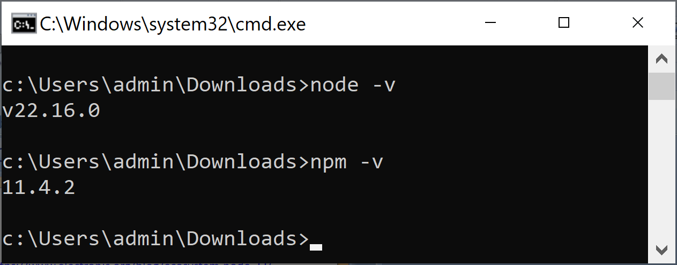
Prerequisites
https://www.electronjs.org/blog/ecosystem-node-22/
node -v
npm -v

Slide 8
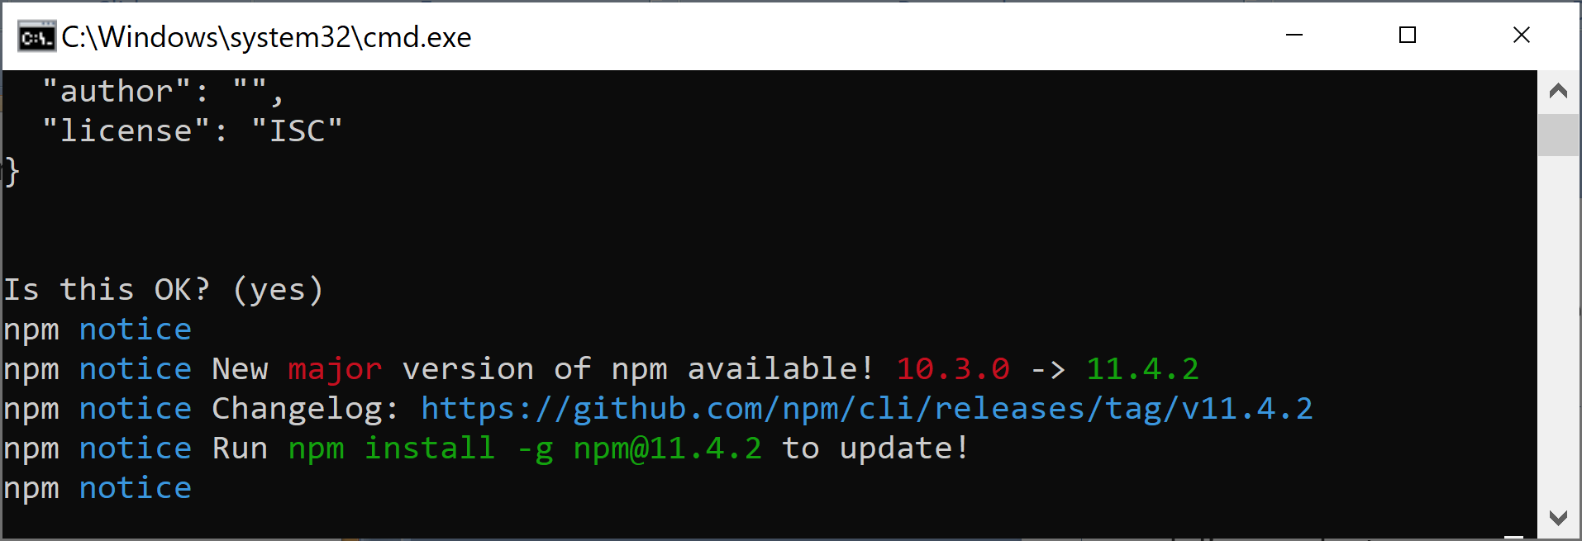
1. Create a Project Structure
https://www.electronjs.org/docs/latest/tutorial/tutorial-first-app
mkdir my-electron-app
cd my-electron-app
npm init

Slide 9
2. Install election Package
npm cache clean --force
npm install electron --save-dev

Slide 10

Thank You & See You Again

